Slide 1
Mobile application for learning English language!

Slide 2

Introduction
In the modern, progressive world, if a person claims something, it is impossible for him to do without knowledge of English. To solve this problem, it was decided to make a mobile application to replenish the vocabulary with new vocabulary. The key feature of this application is the competitive mode, which should promote greater involvement of people in learning new words.

Slide 3

Battle Of Words
This is a mobile application with an original idea that has no analogues on the market.

Slide 4
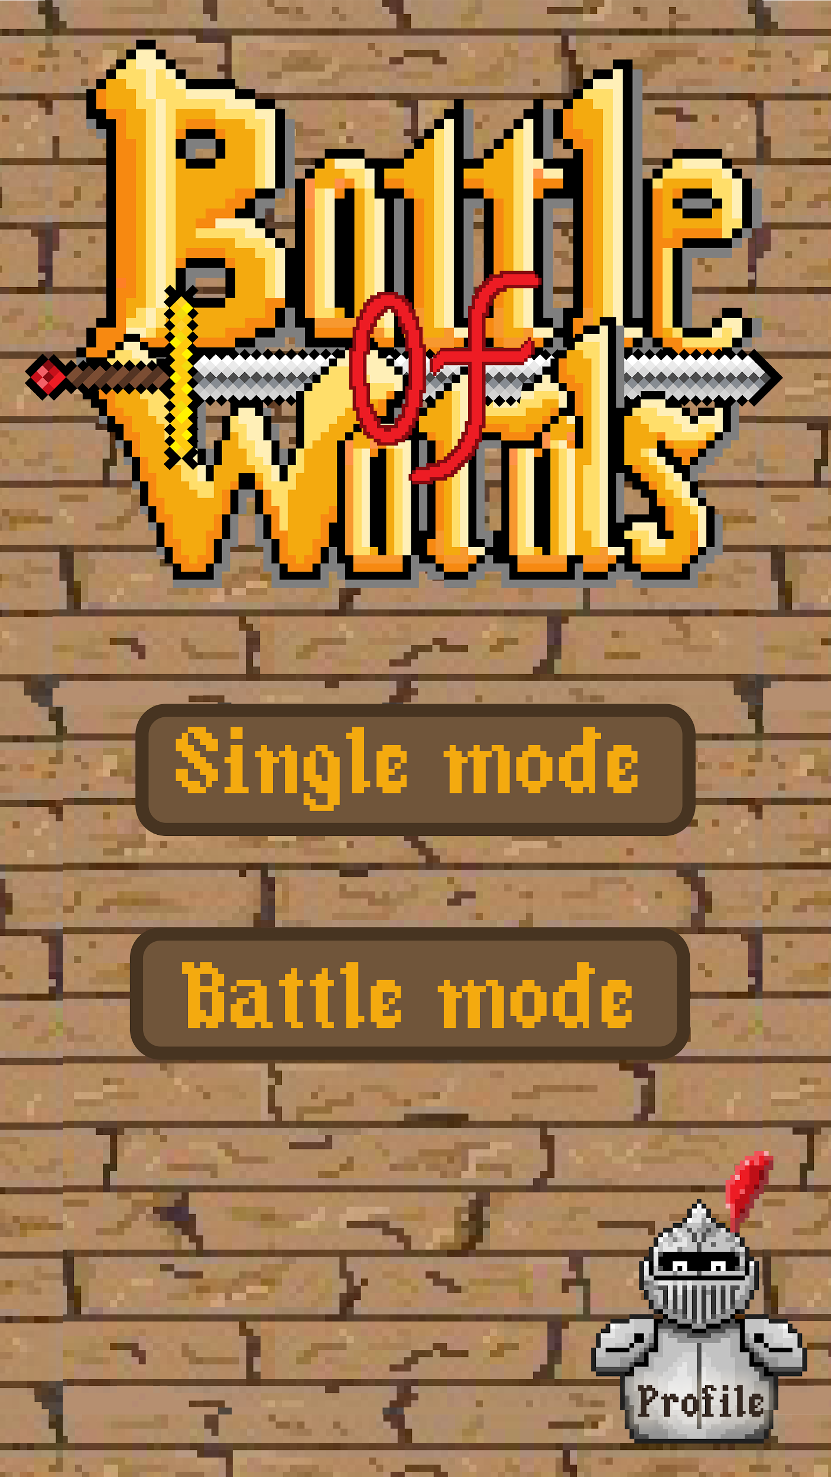
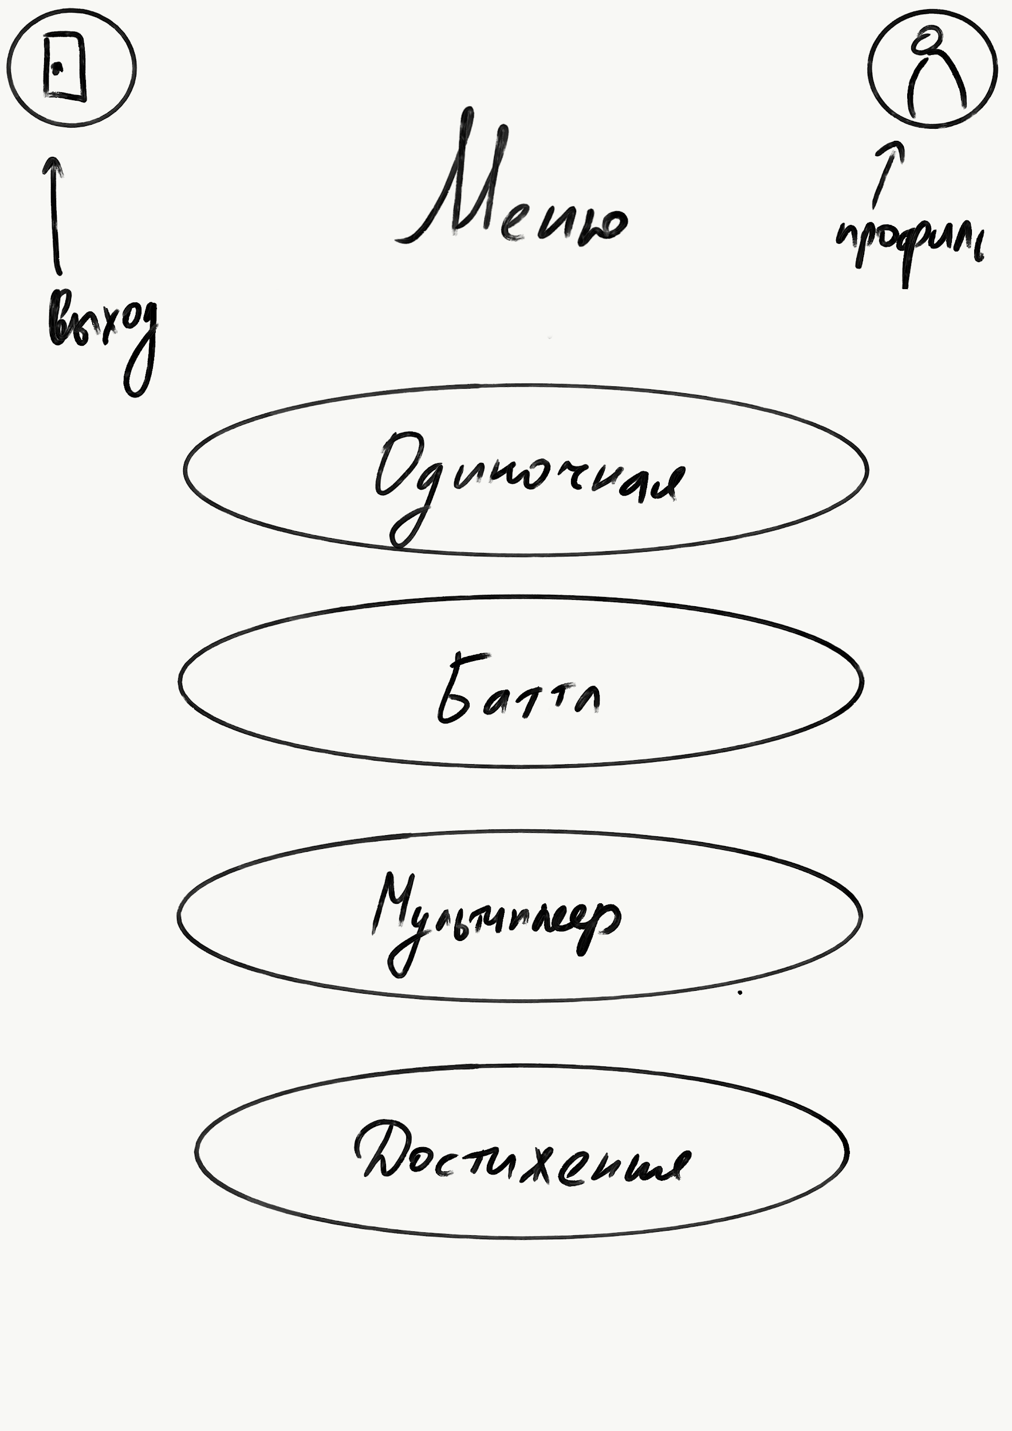
Design
The target audience of our application is people with a need to learn English.
That is why our application should have a bright and modern design, have the simplest possible control.

Slide 5
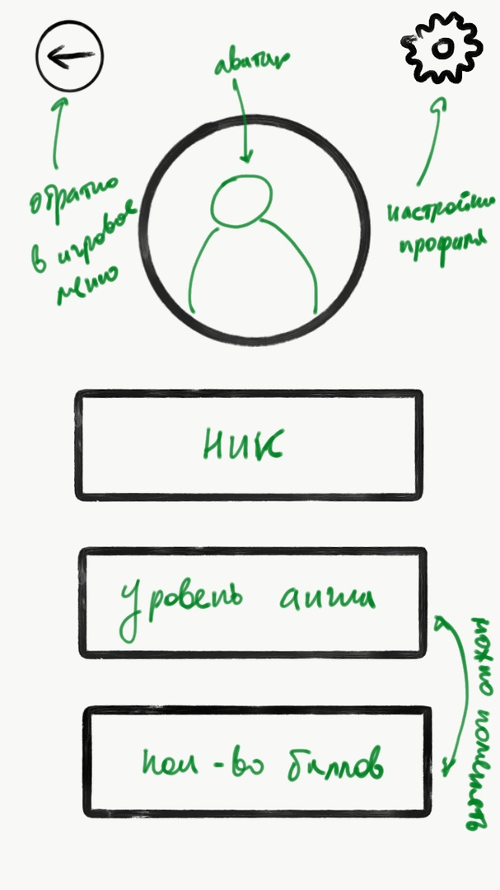
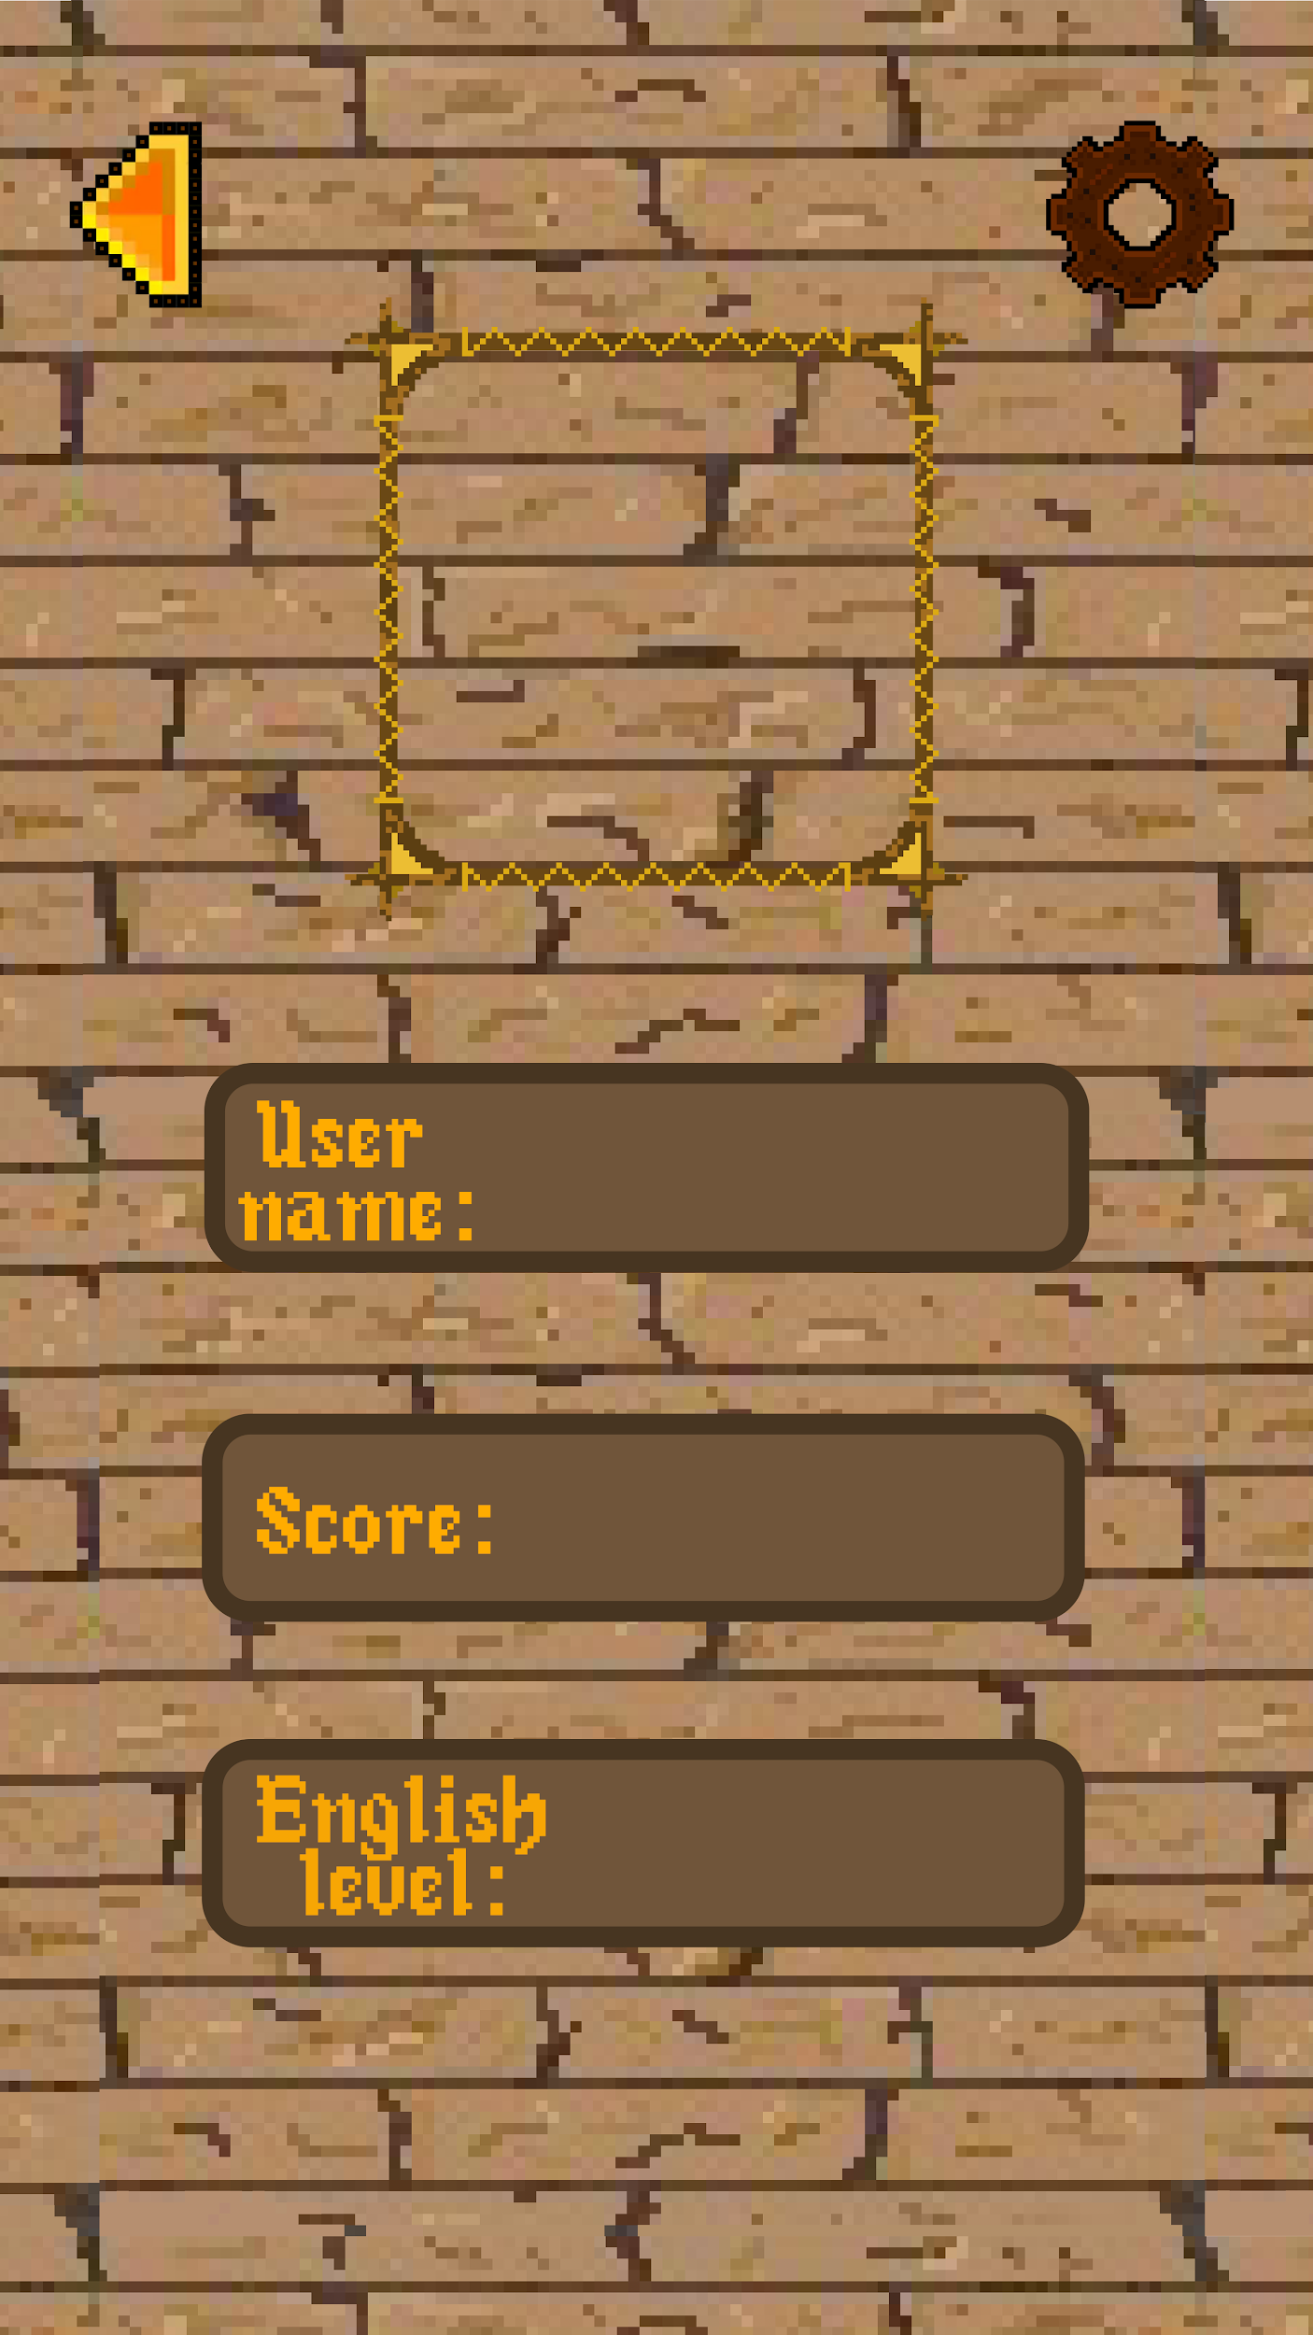







Design

Slide 6


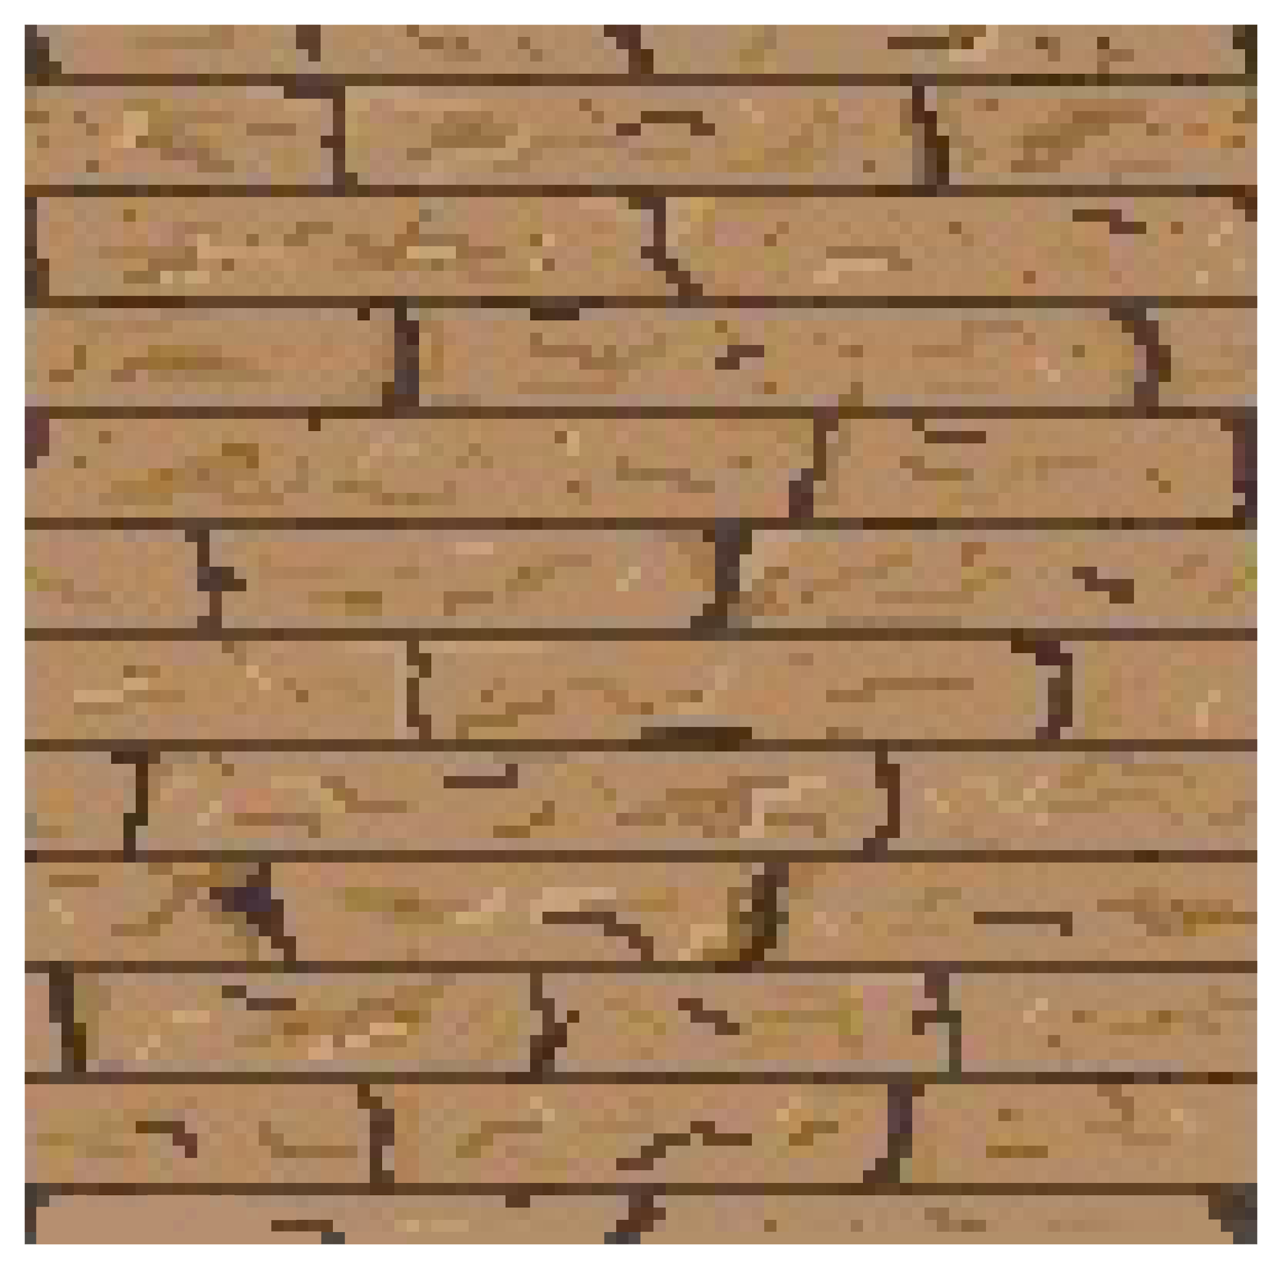



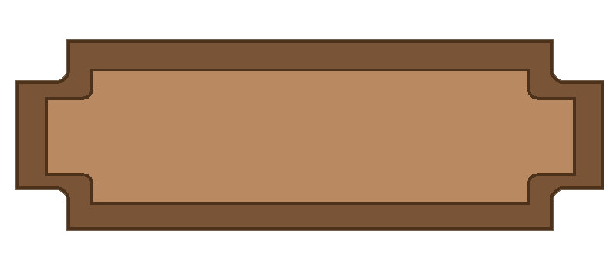
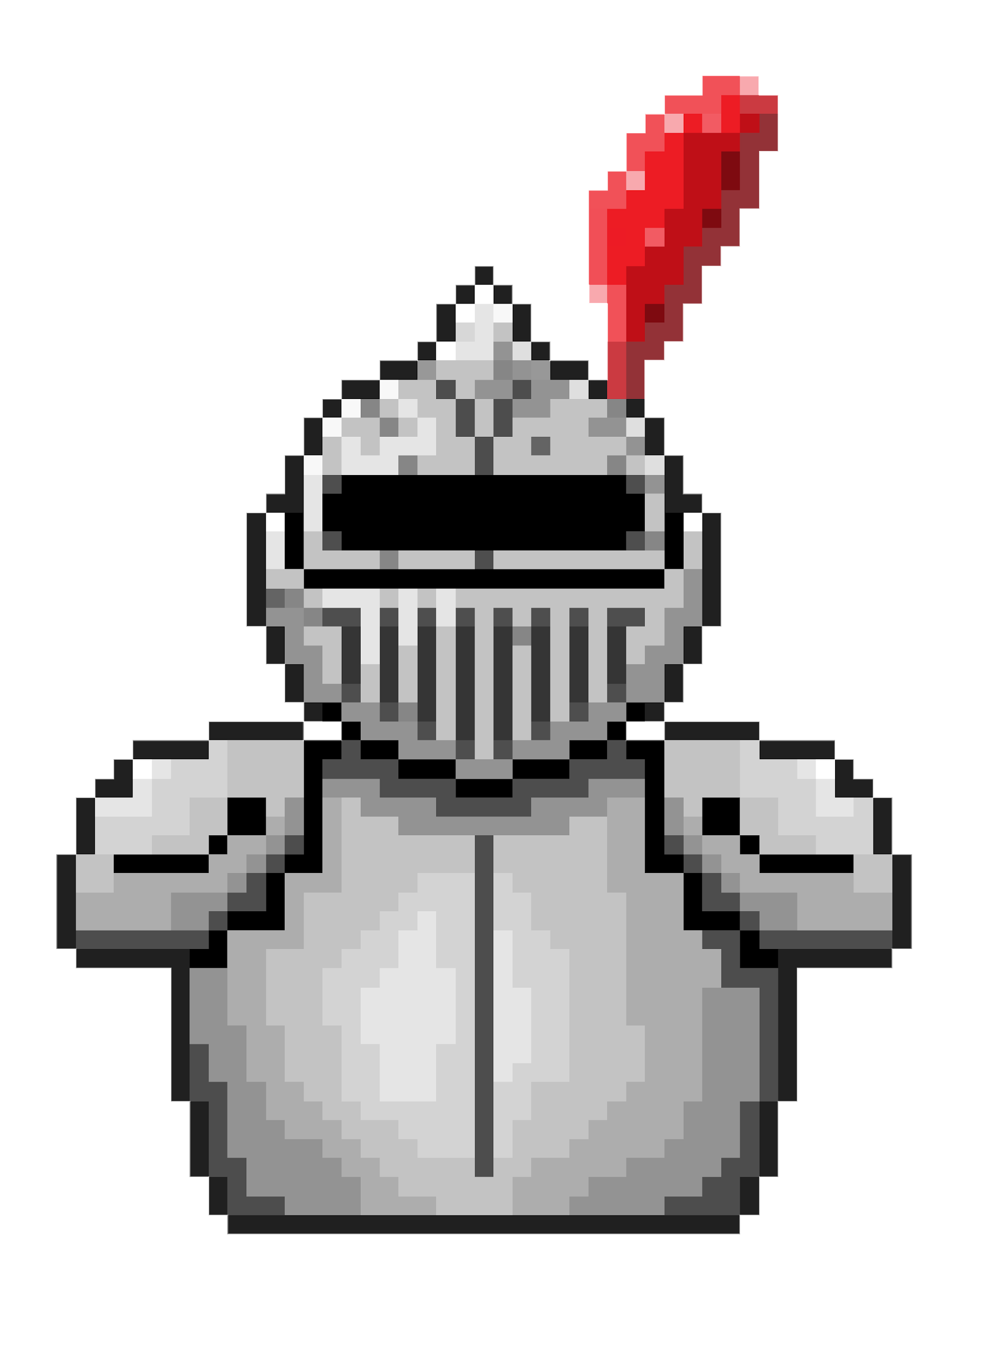





Design

Slide 7





Software development methods and tools.
The software was developed in Unity 2018.20f1 (a cross-platform computer game development environment), in which the programming language was C#.
Editing and optimization of the application code was carried out using JetBrains Rider.
User authentication was performed using Google Firebase.The multiplayer mode was performed using SDL Photon for Unity.

Slide 8
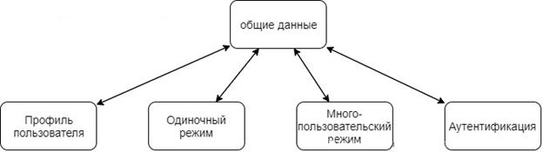
Application Architecture
Repository-based architecture
A repository-based model is used to store data about users and the interaction of individual modules of the system.
User information is stored on the device and duplicated in the database. The dictionary of all words and individual thematic groups is stored in the Firebase Firestore database.

Slide 9

Problems encountered during development
Initial divergence of versions and development tools.
Lack of experience in software development.
Difficulties in design development:
Loss of quality change of the color palette of the logo, elements and background.
Gray stripes on the edges of the background texture.
Difficulties in choosing colors.

Slide 10

Conclusion
1. Acquired skills in working with databases.
2. The basic skills of working in the Unity editor have been acquired.
3. The basics of programming in C# are studied.
4. Acquired the ability to work with the documentation of various services.

Slide 11

Thanks for your attention!
Contact information:
BattleOfWords@gmail.com

